Slide 1
CALLING-CONVENTION-AWARE GLOBAL REGISTER ALLOCATION
Lung Li
Advisor: Keith D. Cooper
Rice University
Mar-31-2014
Notes:
1 MOTIVATION: looking for thesis topic
2. Ls approximated live ranges, but gives a simpler interval.
Relaxes live ranges.
1) reduces complexity
2) interval graph
3) optimal coloring
SSA
Different notion of live ranges.
Helps with complexity
Chordal graph
Optimal coloring
Not optimal allocation
Makes coalescing harder/ more important
improvement
Better spill placement
Better coalescing
Conservative is too conservative
Better measurement
Iterative coalescing
Better spill choice
Precondition to make good local choice
Splitting to make choices regionally
Orthogonal
How do we implement spills
Save/ restore property on boundaries
Code motion for spills
Code motion for copies to find place where there is a spare register.
asdfasdf

Slide 2
MOTIVATION
It’s been almost two years

Slide 3
MOTIVATION-FOR REGISTER ALLOCATION
Speed things up by utilizing registers, the fastest locations in the memory hierarchy
What you write is what you get
  Minimizing unexpected memory footprints

Slide 4
REGISTER ALLOCATION
Cooper and Torczon (P 679):
The register allocator determines, at each point in the program, which values will reside in registers and which register will hold each of those values
Notes:
Registers are the fastest locations in the memory hierarchy.

Slide 5
WHICH VALUES SHOULD YOU PUT IN REGISTERS?
Assuming only two registers are available
Take (v₁, v₂)∙(v₃, v₁) as an example
v₁ * v₃ + v₂ * v₁ | OPERATOR | v₁₋₃ are in loc₁₋₃ |  |  | R₁ | R₂
start | ------ | ------ | --- | --- | --- | ---
v₄ = v₁ * v₃
v₅ = v₂ * v₁
v₆ = v₄ + v₅

Slide 6
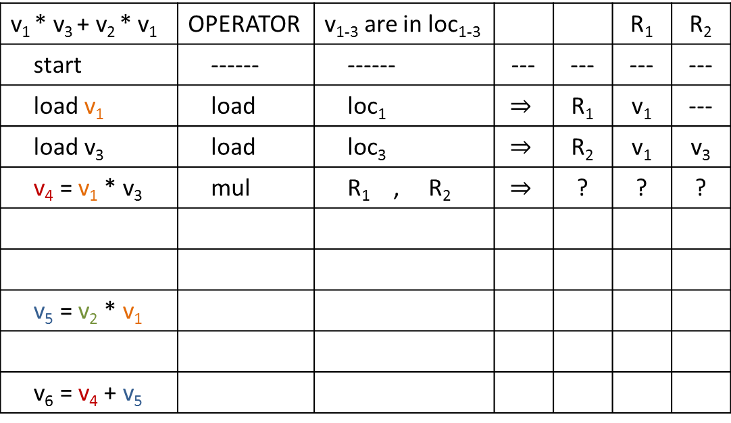
WHICH VALUES SHOULD YOU PUT IN REGISTERS?
Assuming only two registers are available
Take (v₁, v₂)∙(v₃, v₁) as an example
v₁ * v₃ + v₂ * v₁ | OPERATOR | v₁₋₃ are in loc₁₋₃ |  |  | R₁ | R₂
start | ------ | ------ | --- | --- | --- | ---
load v₁ | load | loc₁ | $$⇒$$ | R₁ | v₁ | ---
load v₃ | load | loc₃ | $$⇒$$ | R₂ | v₁ | v₃
v₄ = v₁ * v₃ | mul | R₁ , R₂ | $$⇒$$ | ? | ? | ?
v₅ = v₂ * v₁
v₆ = v₄ + v₅

Slide 7

WHICH VALUES SHOULD YOU PUT IN REGISTERS?
Assuming only two registers are available
Take (v₁, v₂)∙(v₃, v₁) as an example
v₁ * v₃ + v₂ * v₁ | OPERATOR | v₁₋₃ are in loc₁₋₃ |  |  | R₁ | R₂
start | ------ | ------ | --- | --- | --- | ---
load v₁ | load | loc₁ | $$⇒$$ | R₁ | v₁ | ---
load v₃ | load | loc₃ | $$⇒$$ | R₂ | v₁ | v₃
v₄ = v₁ * v₃ | mul | R₁ , R₂ | $$⇒$$ | R₂ | v₁ | v₄
v₅ = v₂ * v₁
v₆ = v₄ + v₅

Slide 8
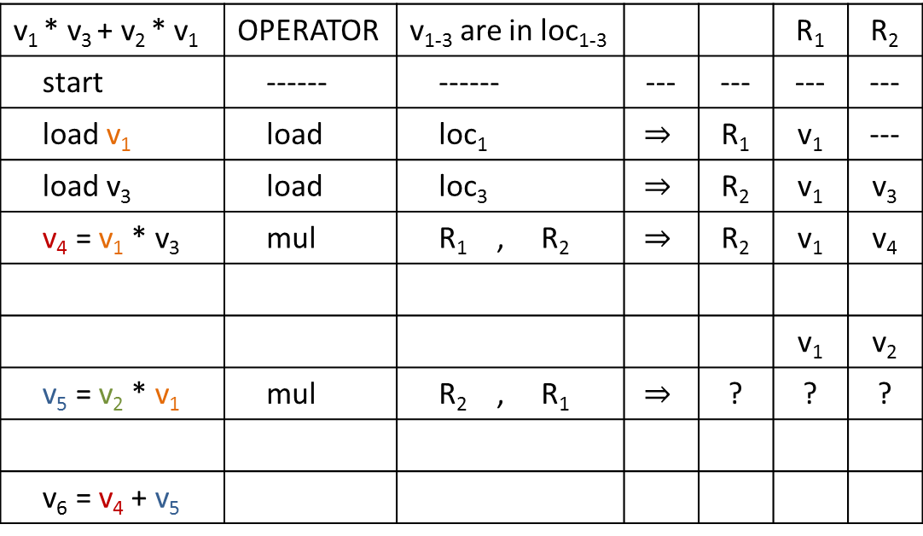
WHICH VALUES SHOULD YOU PUT IN REGISTERS?
Assuming only two registers are available
Take (v₁, v₂)∙(v₃, v₁) as an example
v₁ * v₃ + v₂ * v₁ | OPERATOR | v₁₋₃ are in loc₁₋₃ |  |  | R₁ | R₂
start | ------ | ------ | --- | --- | --- | ---
load v₁ | load | loc₁ | $$⇒$$ | R₁ | v₁ | ---
load v₃ | load | loc₃ | $$⇒$$ | R₂ | v₁ | v₃
v₄ = v₁ * v₃ | mul | R₁ , R₂ | $$⇒$$ | R₂ | v₁ | v₄
 |  |  |  |  | v₁ | v₂
v₅ = v₂ * v₁ | mul | R₂ , R₁ | $$⇒$$ | ? | ? | ?
v₆ = v₄ + v₅

Slide 9
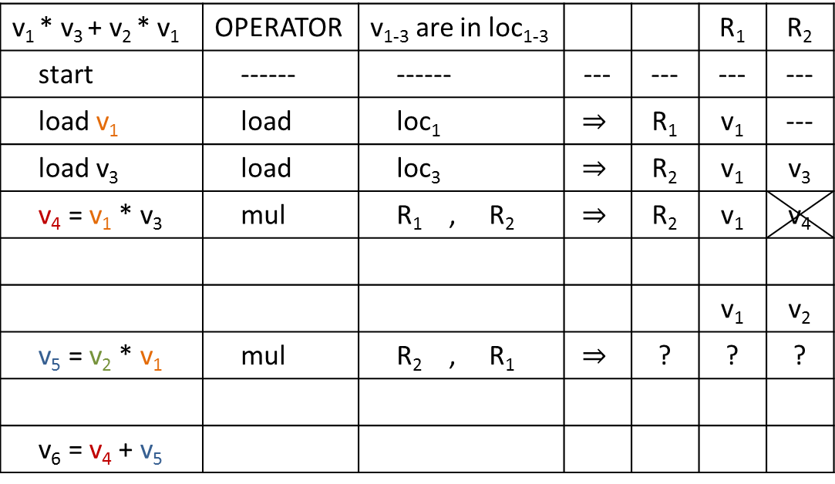
WHICH VALUES SHOULD YOU PUT IN REGISTERS?
Assuming only two registers are available
Take (v₁, v₂)∙(v₃, v₁) as an example
v₁ * v₃ + v₂ * v₁ | OPERATOR | v₁₋₃ are in loc₁₋₃ |  |  | R₁ | R₂
start | ------ | ------ | --- | --- | --- | ---
load v₁ | load | loc₁ | $$⇒$$ | R₁ | v₁ | ---
load v₃ | load | loc₃ | $$⇒$$ | R₂ | v₁ | v₃
v₄ = v₁ * v₃ | mul | R₁ , R₂ | $$⇒$$ | R₂ | v₁ | v₄
 |  |  |  |  | v₁ | v₂
v₅ = v₂ * v₁ | mul | R₂ , R₁ | $$⇒$$ | ? | ? | ?
v₆ = v₄ + v₅

Slide 10
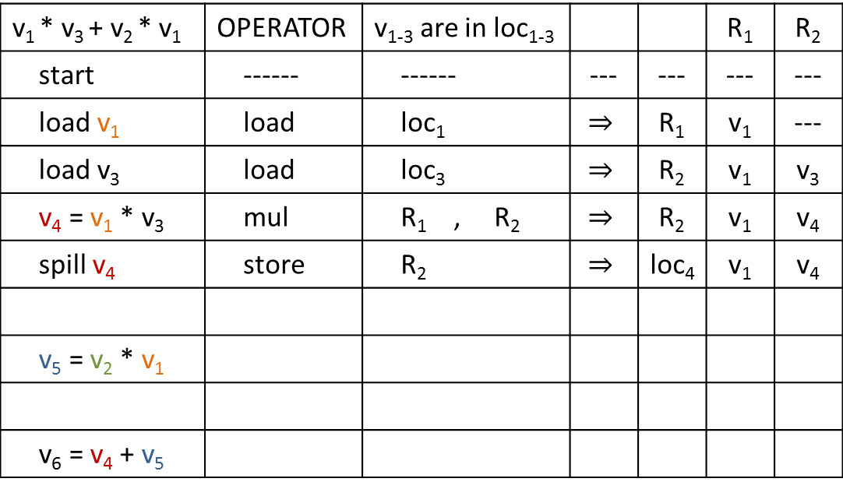
WHICH VALUES SHOULD YOU PUT IN REGISTERS?
Assuming only two registers are available
Take (v₁, v₂)∙(v₃, v₁) as an example
v₁ * v₃ + v₂ * v₁ | OPERATOR | v₁₋₃ are in loc₁₋₃ |  |  | R₁ | R₂
start | ------ | ------ | --- | --- | --- | ---
load v₁ | load | loc₁ | $$⇒$$ | R₁ | v₁ | ---
load v₃ | load | loc₃ | $$⇒$$ | R₂ | v₁ | v₃
v₄ = v₁ * v₃ | mul | R₁ , R₂ | $$⇒$$ | R₂ | v₁ | v₄
spill v₄ | store | R₂ | $$⇒$$ | loc₄ | v₁ | v₄
v₅ = v₂ * v₁
v₆ = v₄ + v₅

Slide 11
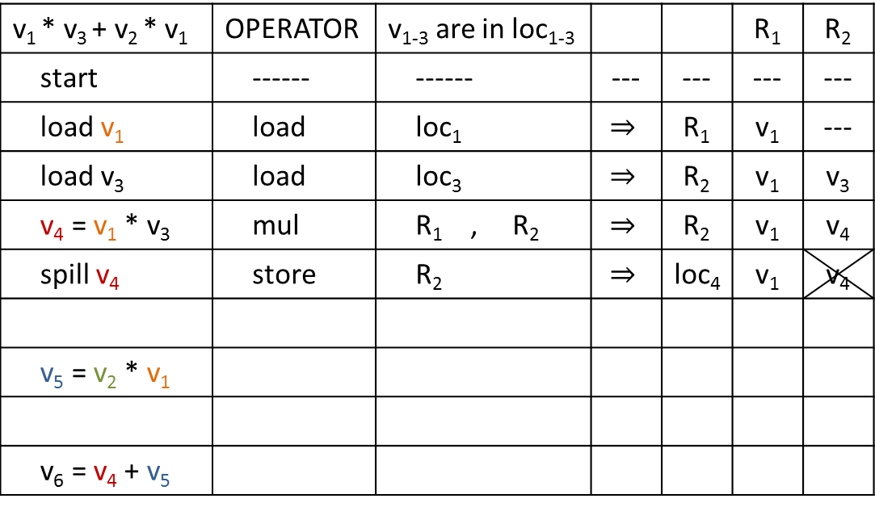
WHICH VALUES SHOULD YOU PUT IN REGISTERS?
Assuming only two registers are available
Take (v₁, v₂)∙(v₃, v₁) as an example
v₁ * v₃ + v₂ * v₁ | OPERATOR | v₁₋₃ are in loc₁₋₃ |  |  | R₁ | R₂
start | ------ | ------ | --- | --- | --- | ---
load v₁ | load | loc₁ | $$⇒$$ | R₁ | v₁ | ---
load v₃ | load | loc₃ | $$⇒$$ | R₂ | v₁ | v₃
v₄ = v₁ * v₃ | mul | R₁ , R₂ | $$⇒$$ | R₂ | v₁ | v₄
spill v₄ | store | R₂ | $$⇒$$ | loc₄ | v₁ | v₄
v₅ = v₂ * v₁
v₆ = v₄ + v₅

Slide 12
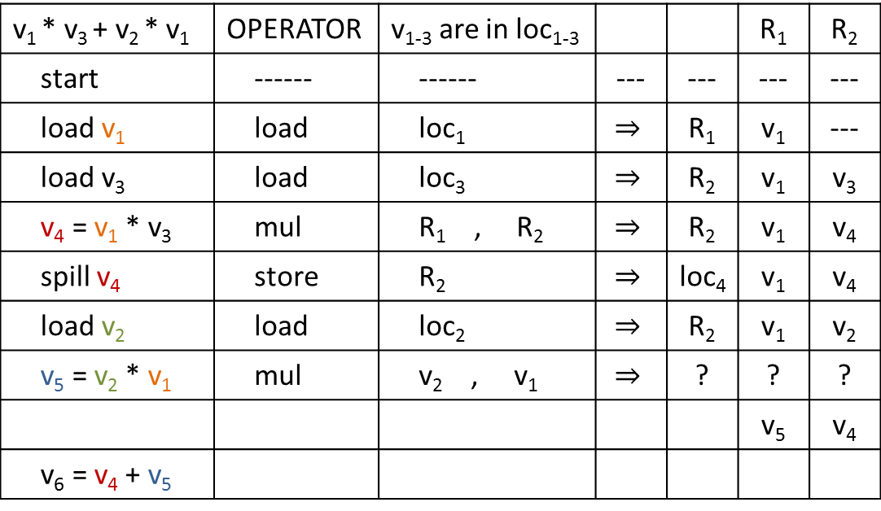
WHICH VALUES SHOULD YOU PUT IN REGISTERS?
Assuming only two registers are available
Take (v₁, v₂)∙(v₃, v₁) as an example
v₁ * v₃ + v₂ * v₁ | OPERATOR | v₁₋₃ are in loc₁₋₃ |  |  | R₁ | R₂
start | ------ | ------ | --- | --- | --- | ---
load v₁ | load | loc₁ | $$⇒$$ | R₁ | v₁ | ---
load v₃ | load | loc₃ | $$⇒$$ | R₂ | v₁ | v₃
v₄ = v₁ * v₃ | mul | R₁ , R₂ | $$⇒$$ | R₂ | v₁ | v₄
spill v₄ | store | R₂ | $$⇒$$ | loc₄ | v₁ | v₄
load v₂ | load | loc₂ | $$⇒$$ | R₂ | v₁ | v₂
v₅ = v₂ * v₁ | mul | v₂ , v₁ | $$⇒$$ | ? | ? | ?
 |  |  |  |  | v₅ | v₄
v₆ = v₄ + v₅

Slide 13

WHICH VALUES SHOULD YOU PUT IN REGISTERS?
Assuming only two registers are available
Take (v₁, v₂)∙(v₃, v₁) as an example
v₁ * v₃ + v₂ * v₁ | OPERATOR | v₁₋₃ are in loc₁₋₃ |  |  | R₁ | R₂
start | ------ | ------ | --- | --- | --- | ---
load v₁ | load | loc₁ | $$⇒$$ | R₁ | v₁ | ---
load v₃ | load | loc₃ | $$⇒$$ | R₂ | v₁ | v₃
v₄ = v₁ * v₃ | mul | R₁ , R₂ | $$⇒$$ | R₂ | v₁ | v₄
spill v₄ | store | R₂ | $$⇒$$ | loc₄ | v₁ | v₄
load v₂ | load | loc₂ | $$⇒$$ | R₂ | v₁ | v₂
v₅ = v₂ * v₁ | mul | v₂ , v₁ | $$⇒$$ | R₁ | v₅ | v₂
v₆ = v₄ + v₅

Slide 14
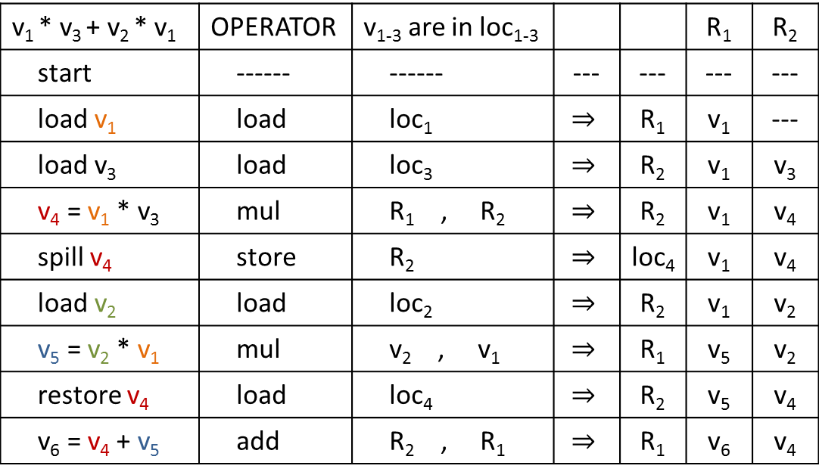
WHICH VALUES SHOULD YOU PUT IN REGISTERS?
Assuming only two registers are available
Take (v₁, v₂)∙(v₃, v₁) as an example
v₁ * v₃ + v₂ * v₁ | OPERATOR | v₁₋₃ are in loc₁₋₃ |  |  | R₁ | R₂
start | ------ | ------ | --- | --- | --- | ---
load v₁ | load | loc₁ | $$⇒$$ | R₁ | v₁ | ---
load v₃ | load | loc₃ | $$⇒$$ | R₂ | v₁ | v₃
v₄ = v₁ * v₃ | mul | R₁ , R₂ | $$⇒$$ | R₂ | v₁ | v₄
spill v₄ | store | R₂ | $$⇒$$ | loc₄ | v₁ | v₄
load v₂ | load | loc₂ | $$⇒$$ | R₂ | v₁ | v₂
v₅ = v₂ * v₁ | mul | v₂ , v₁ | $$⇒$$ | R₁ | v₅ | v₂
restore v₄ | load | loc₄ | $$⇒$$ | R₂ | v₅ | v₄
v₆ = v₄ + v₅ | add | R₂ , R₁ | $$⇒$$ | R₁ | v₆ | v₄

Slide 15
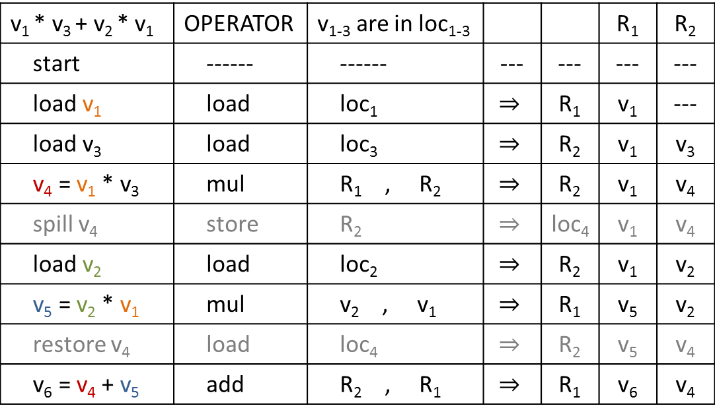
WHICH VALUES SHOULD YOU PUT IN REGISTERS?
Assuming only two registers are available
Take (v₁, v₂)∙(v₃, v₁) as an example
v₁ * v₃ + v₂ * v₁ | OPERATOR | v₁₋₃ are in loc₁₋₃ |  |  | R₁ | R₂
start | ------ | ------ | --- | --- | --- | ---
load v₁ | load | loc₁ | $$⇒$$ | R₁ | v₁ | ---
load v₃ | load | loc₃ | $$⇒$$ | R₂ | v₁ | v₃
v₄ = v₁ * v₃ | mul | R₁ , R₂ | $$⇒$$ | R₂ | v₁ | v₄
spill v₄ | store | R₂ | $$⇒$$ | loc₄ | v₁ | v₄
load v₂ | load | loc₂ | $$⇒$$ | R₂ | v₁ | v₂
v₅ = v₂ * v₁ | mul | v₂ , v₁ | $$⇒$$ | R₁ | v₅ | v₂
restore v₄ | load | loc₄ | $$⇒$$ | R₂ | v₅ | v₄
v₆ = v₄ + v₅ | add | R₂ , R₁ | $$⇒$$ | R₁ | v₆ | v₄

Slide 16
WHICH VALUES SHOULD YOU PUT IN REGISTERS?
Assuming only two registers are available
Take (v₁, v₂)∙(v₃, v₁) as an example
v₁ * v₃ + v₂ * v₁ | OPERATOR | v₁₋₃ are in loc₁₋₃ |  |  | R₁ | R₂
start | ------ | ------ | --- | --- | --- | ---
load v₁ | load | loc₁ | $$⇒$$ | R₁ | v₁ | ---
load v₃ | load | loc₃ | $$⇒$$ | R₂ | v₁ | v₃
v₄ = v₁ * v₃ | mul | R₁ , R₂ | $$⇒$$ | R₂ | v₁ | v₄
spill v₄ | store | R₂ | $$⇒$$ | loc₄ | v₁ | v₄
load v₂ | load | loc₂ | $$⇒$$ | R₂ | v₁ | v₂
v₅ = v₂ * v₁ | mul | v₂ , v₁ | $$⇒$$ | R₁ | v₅ | v₂
restore v₄ | load | loc₄ | $$⇒$$ | R₂ | v₅ | v₄
v₆ = v₄ + v₅ | add | R₂ , R₁ | $$⇒$$ | R₁ | v₆ | v₄

Slide 17

WHICH VALUES SHOULD YOU PUT IN REGISTERS?
Assuming only two registers are available
Take (v₁, v₂)∙(v₃, v₁) as an example
TRY TO MAP
6 VALUES TO 2 REGISTERS
v₁ * v₃ + v₂ * v₁ | OPERATOR | v₁₋₃ are in loc₁₋₃ |  |  | R₁ | R₂
start | ------ | ------ | --- | --- | --- | ---
load v₁ | load | loc₁ | $$⇒$$ | R₁ | v₁ | ---
load v₃ | load | loc₃ | $$⇒$$ | R₂ | v₁ | v₃
v₄ = v₁ * v₃ | mul | R₁ , R₂ | $$⇒$$ | R₁ | v₁ | v₄
spill v₄ | store | R₂ | $$⇒$$ | loc₄ | v₁ | v₄
load v₂ | load | loc₂ | $$⇒$$ | R₂ | v₁ | v₂
v₅ = v₂ * v₁ | mul | v₂ , v₁ | $$⇒$$ | R₁ | v₅ | v₂
restore v₄ | load | loc₄ | $$⇒$$ | R₂ | v₅ | v₄
v₆ = v₄ + v₅ | add | R₂ , R₁ | $$⇒$$ | R₁ | v₆ | v₄

Slide 18
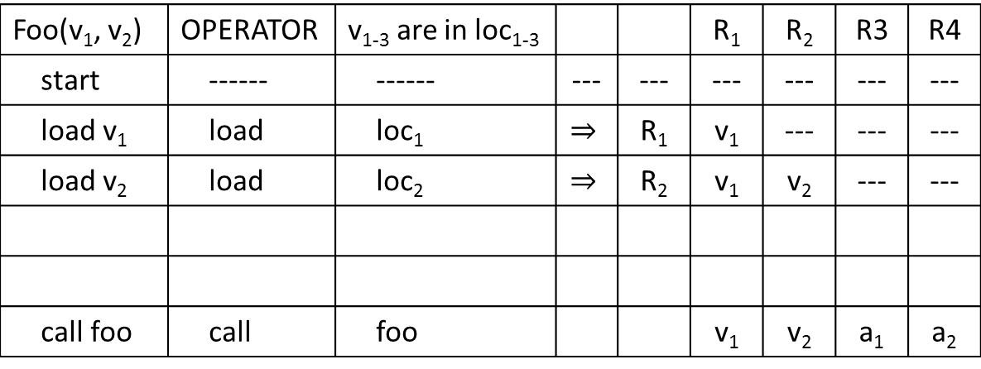
WHICH VALUES SHOULD YOU PUT IN REGISTERS?
Assuming four registers are available but
R₃ and R₄ are for parameter passing
Take foo(v₁, v₂) as an example
Foo(v₁, v₂) | OPERATOR | v₁₋₃ are in loc₁₋₃ |  |  | R₁ | R₂ | R3 | R4
start | ------ | ------ | --- | --- | --- | --- | --- | ---
load v₁ | load | loc₁ | $$⇒$$ | R₁ | v₁ | --- | --- | ---
load v₂ | load | loc₂ | $$⇒$$ | R₂ | v₁ | v₂ | --- | ---
call foo | call | foo |  |  | v₁ | v₂ | a₁ | a₂

Slide 19
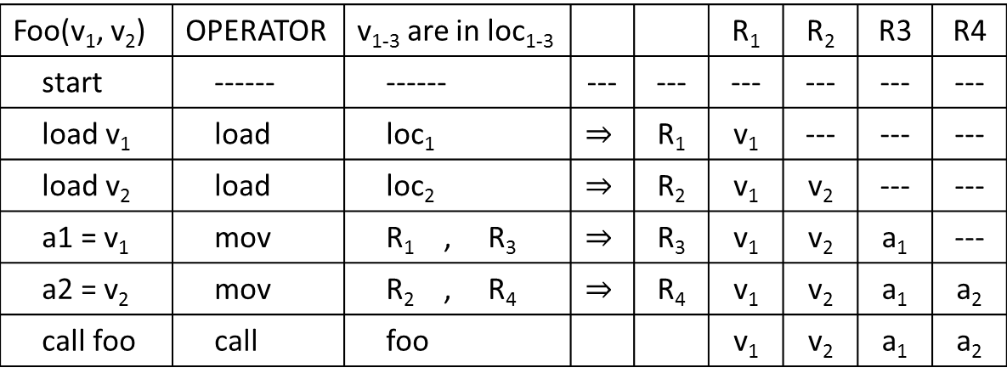
WHICH VALUES SHOULD YOU PUT IN REGISTERS?
Assuming four registers are available but
R₃ and R₄ are for parameter passing
Take foo(v₁, v₂) as an example
Foo(v₁, v₂) | OPERATOR | v₁₋₃ are in loc₁₋₃ |  |  | R₁ | R₂ | R3 | R4
start | ------ | ------ | --- | --- | --- | --- | --- | ---
load v₁ | load | loc₁ | $$⇒$$ | R₁ | v₁ | --- | --- | ---
load v₂ | load | loc₂ | $$⇒$$ | R₂ | v₁ | v₂ | --- | ---
a1 = v₁ | mov | R₁ , R₃ | $$⇒$$ | R₃ | v₁ | v₂ | a₁ | ---
a2 = v₂ | mov | R₂ , R₄ | $$⇒$$ | R₄ | v₁ | v₂ | a₁ | a₂
call foo | call | foo |  |  | v₁ | v₂ | a₁ | a₂

Slide 20
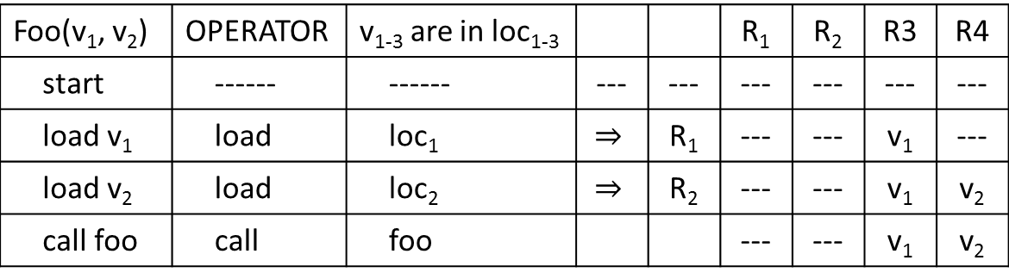
WHICH VALUES SHOULD YOU PUT IN REGISTERS?
Assuming four registers are available but
R₃ and R₄ are for parameter passing
Take foo(v₁, v₂) as an example
Foo(v₁, v₂) | OPERATOR | v₁₋₃ are in loc₁₋₃ |  |  | R₁ | R₂ | R3 | R4
start | ------ | ------ | --- | --- | --- | --- | --- | ---
load v₁ | load | loc₁ | $$⇒$$ | R₁ | --- | --- | v₁ | ---
load v₂ | load | loc₂ | $$⇒$$ | R₂ | --- | --- | v₁ | v₂
call foo | call | foo |  |  | --- | --- | v₁ | v₂

Slide 21
WHICH VALUES SHOULD YOU PUT IN REGISTERS?
Assuming four registers are available but
R₃ and R₄ are for parameter passing
Take foo(v₁, v₂) as an example
TRY TO MINIMIZE
COPY/MOVE INSTRUCTIONS
Foo(v₁, v₂) | OPERATOR | v₁₋₃ are in loc₁₋₃ |  |  | R₁ | R₂ | R3 | R4
start | ------ | ------ | --- | --- | --- | --- | --- | ---
load v₁ | load | loc₁ | $$⇒$$ | R₁ | --- | --- | v₁ | ---
load v₂ | load | loc₂ | $$⇒$$ | R₂ | --- | --- | v₁ | v₂
call foo | call | foo |  |  | --- | --- | v₁ | v₂

Slide 22
WHAT HAS BEEN OVERLOOKED
…the effects of the calling convention are ignored.

Slide 23
WHAT HAPPENS WITH FUNCTION CALLS
Foo(){
a = ...;
b = ...;
c = ...;
bar(a, b);
…
}
Bar(int a, int b){
…
}

Slide 24
WHAT GLOBAL REGISTER ALLOCATOR SEES
Foo(){
a = ...;
b = ...;
c = ...;
NOP;
…
}
Bar(int a, int b){
…
}

Slide 25
WHAT ACTUALLY HAPPENS
Foo(){
a = ...;
b = ...;
c = ...;
spill c;
create a frame for bar
bar(a, b);
restore c;
…
}
Bar(int a, int b){
//spill a;
//spill b;
…
//restore a;
//restore b;
destroy this frame
}

Slide 26
OBSERVATIONS
The additional code for calling convention is not seen by the global register allocators
Can have more caller-save registers
  Save all values that are not modified in the callee instead of all that are not used in the callee

Slide 27
IF CALLING CONVENTION IS SEEN
Bar(int a, int b){
//spill a;
//spill b;
…
//restore a;
//restore b;
destroy this frame
}
Foo(){
a = ...;
b = ...;
c = ...;
spill c;
create a frame for bar
bar(a, b);
restore c;
e = …
f = a + b;
g = c + …;
…
}

Slide 28
IF CALLING CONVENTION IS SEEN
Bar(int a, int b){
//spill a;
//spill b;
…
//restore a;
//restore b;
destroy this frame
}
Foo(){
a = ...;
b = ...;
c = ...;
spill c;
create a frame for bar
bar(a, b);
//restore c;
e = …
f = a + b;
restore c;
g = c + …;
…
}
Don’t restore right after the call
restore right before the use

Slide 29
IF CALLING CONVENTION IS IGNORED
Bar(int a, int b){
//spill a;
//spill b;
…
//restore a;
//restore b;
destroy this frame
}
Foo(){
a = ...;
b = ...;
c = ...;
//spill c;
//create a frame for bar
NOP; //bar(a, b);
//restore c;
e = …
f = a + b;
g = c + …;
…
}
We have four live values but
Only three register are available.
Let’s spill c.

Slide 30
IF CALLING CONVENTION IS IGNORED
Bar(int a, int b){
//spill a;
//spill b;
…
//restore a;
//restore b;
destroy this frame
}
Foo(){
a = ...;
b = ...;
c = ...;
//spill c;
//create a frame for bar
NOP; //bar(a, b);
//restore c;
spill c;
e = …
f = a + b;
restore c;
g = c + …;
…
}

Slide 31
IF CALLING CONVENTION IS IGNORED
Bar(int a, int b){
//spill a;
//spill b;
…
//restore a;
//restore b;
destroy this frame
}
Foo(){
a = ...;
b = ...;
c = ...;
spill c;
create a frame for bar
bar(a, b);
restore c;
spill c;
e = …
f = a + b;
restore c;
g = c + …;
…
}
Redundant restore and spill

Slide 32
IS THIS A GOOD DIVISION BETWEEN
CALLER-SAVE AND CALLEE SAVE?
Bar(int a, int b){
//spill a;
//spill b;
…
//restore a;
//restore b;
destroy this frame
}
Foo(){
a = ...;
b = ...;
c = ...; //CALLER-SAVE
spill c;
create a frame for bar
bar(a, b);
//restore c;
e = …
f = a + b;
g = c + …;
…
}
CALLEE-SAVE

Slide 33
IS THIS A GOOD DIVISION BETWEEN
CALLER-SAVE AND CALLEE SAVE?
Bar(int a, int b){
//spill a;
//spill b;
…
//restore a;
//restore b;
destroy this frame
}
Foo(){
a = ...; //CALLER-SAVE
b = ...; //CALLER-SAVE
c = ...; //CALLER-SAVE
spill c;
spill b;
spill a;
create a frame for bar
bar(a, b);
//restore a;
//restore b;
//restore c;
e = …
f = a + b;
g = c + …;
…
}

Slide 34
WHY CAN WE DO THIS?
The same value is saved, whether it’s saved before a call or during the creation of the frame for the call.
The same value is restored, whether it’s saved before the destruction of the frame or after the call.

Slide 35
SHOULD ALL REGISTERS BE CALLER-SAVE?
No, modification to a global value won’t be captured by Caller saves and thus violates the program behavior, if spill for a global value is stored in the stack
In addition, in call-by-reference programs, some values in the registers may be modified
Only those are not modified can be caller-save

Slide 36
REDEFINE THE CALLING CONVENTION
Caller-save registers:
  Registers whose value are not used in callee
  Save and restore by caller
  Value saved in Caller’s activation record
Callee-save registers:
  Registers whose value are used by callee
  Save by Callee
  Restore by Callee
  Value saved in Callee’s activation record

Slide 37
REDEFINE THE CALLING CONVENTION
Caller-save registers:
  Registers whose value are not modified in callee
  Save and restore by caller
  Value saved in Caller’s activation record
Callee-save registers:
  Registers whose value may be modified by callee
  Save by Callee
  Restore by Caller
  Value saved in Caller’s activation record

Slide 38
PROPOSED FRAMEWORK
Bottom up traverse the call graph, for each func:
for each proper call-site:
CCC-insert(callee)
do global register allocation
record set of modified caller-save registers
record last restore for callee-save registers
remove last restore for callee-save registers
CCC-insert(callee):
insert necessary spill codes before the call-site
insert necessary restore codes after the call-site and right before the use of the value

Slide 39
FUTURE WORK & CONCLUSION
Future work
  Recursion
  Implement our design
  Get data
  Code motion with register allocation
  Post allocation optimization
Conclusion:
  The effect of calling convention should not be ignored in global register allocation
  Being aware of the effects simplifies register allocation
  Should lead to better result

